Slide 1
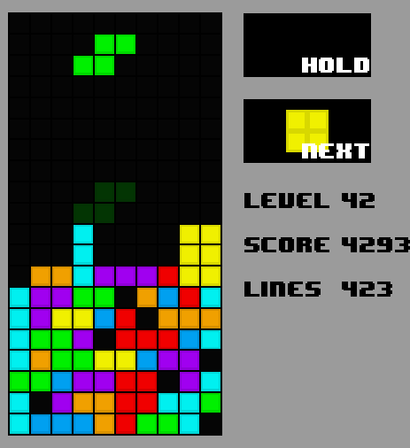
Can a Tetris learner create a strategy to minimize the risk from input randomness?
What I’m doing:
There is a need to create machine learners that can create strategies to reduce the risk they encounter from the unpredictable aspects of their environment.
How I’m doing it:
Imposing limitations on the neural network in order to “slow it down” and make it more human-like.
Experimenting with different state representations.

Slide 2
Methods
2-dimensional grid as Tetris board, condensed into n statistics (rows cleared, holes, bumpiness, etc.) using the following algorithms. Statistics passed to agent as the state.
Dellacherie’s Algorithm: 9 statistics, cell-focused state representation
EL-Tetris: 7 statistics, row-focused state representation
Limited Reaction Speeds. By default, agent can determine best action in a single frame.
Limited reaction speeds by a factor of 2x and 3x.
Tested all combinations of reaction speeds and state representations.

Slide 3
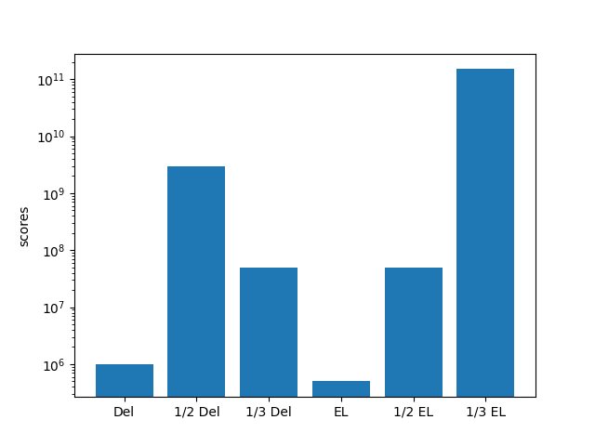
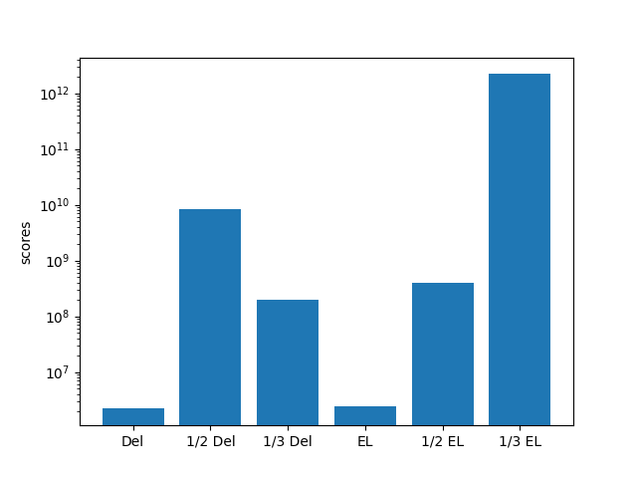
Results
Mean
Max

Slide 4
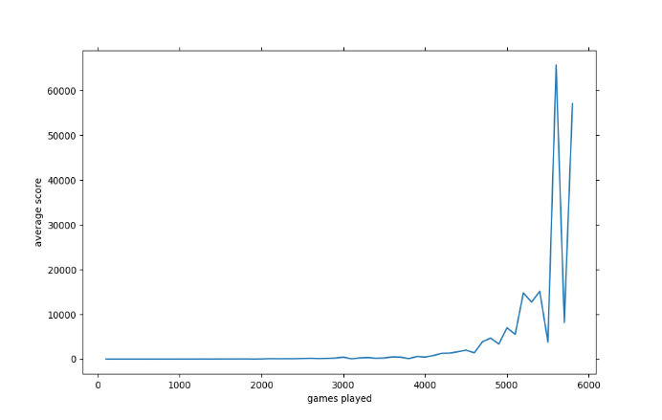
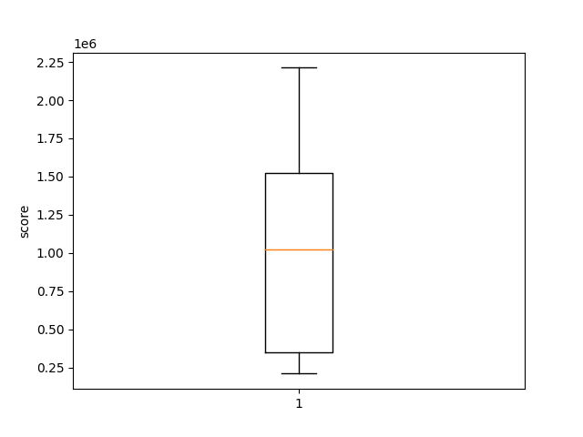
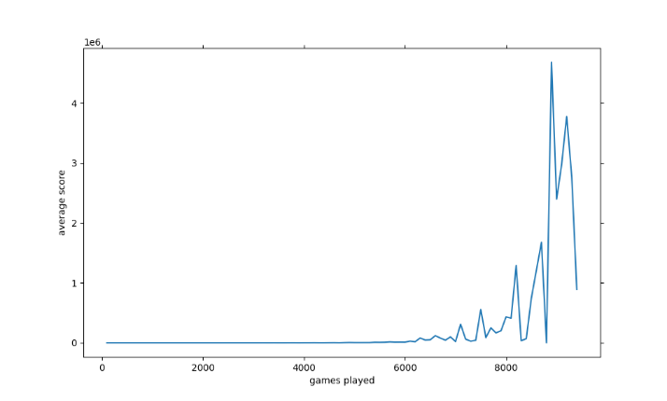
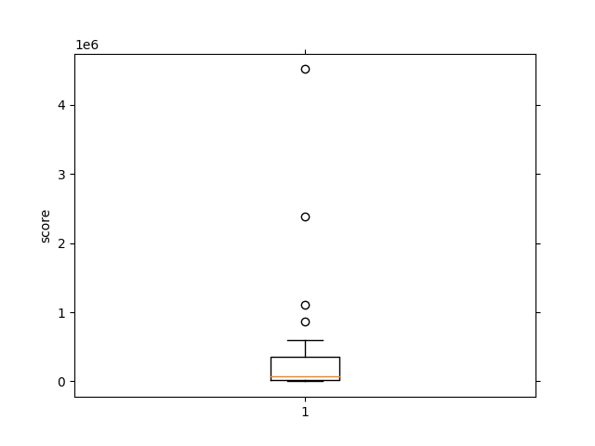
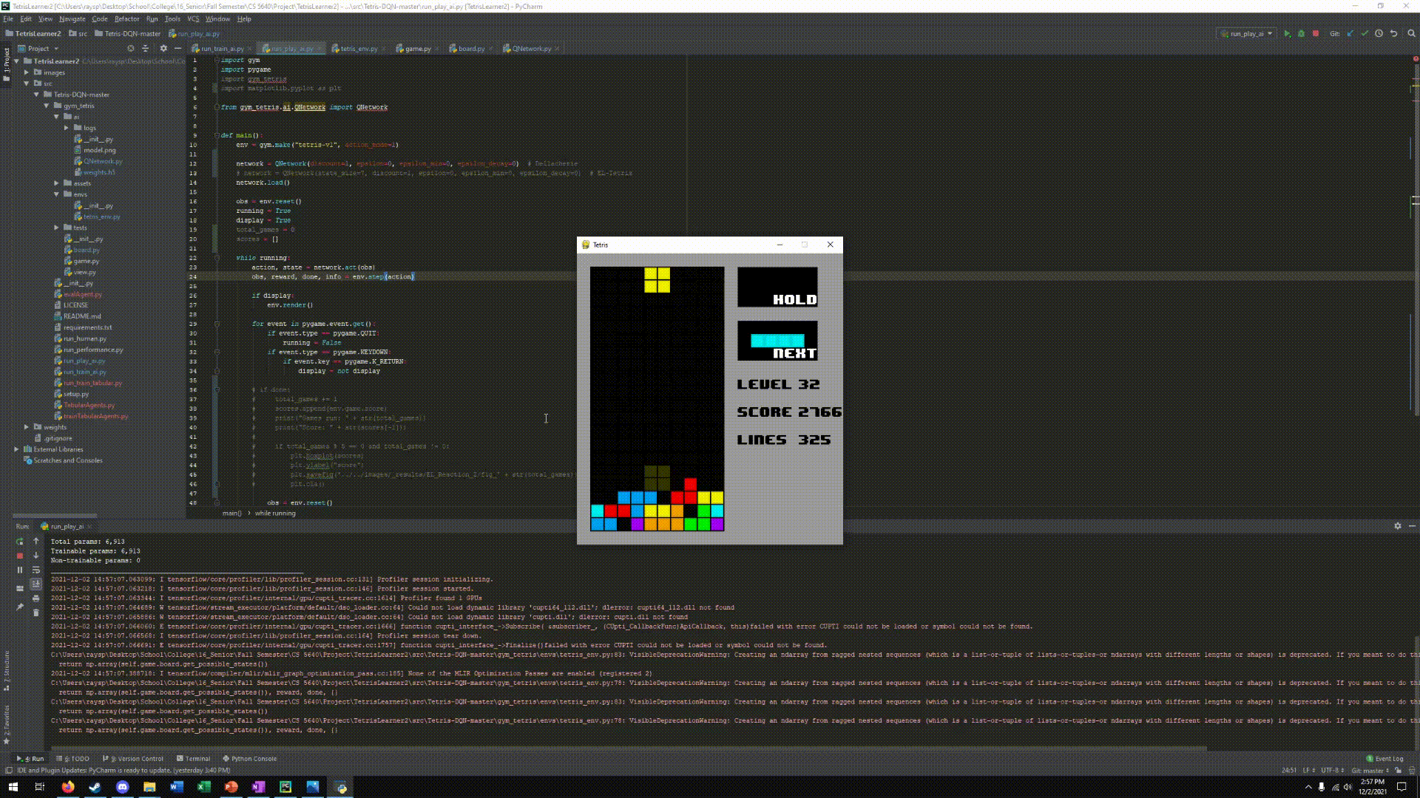
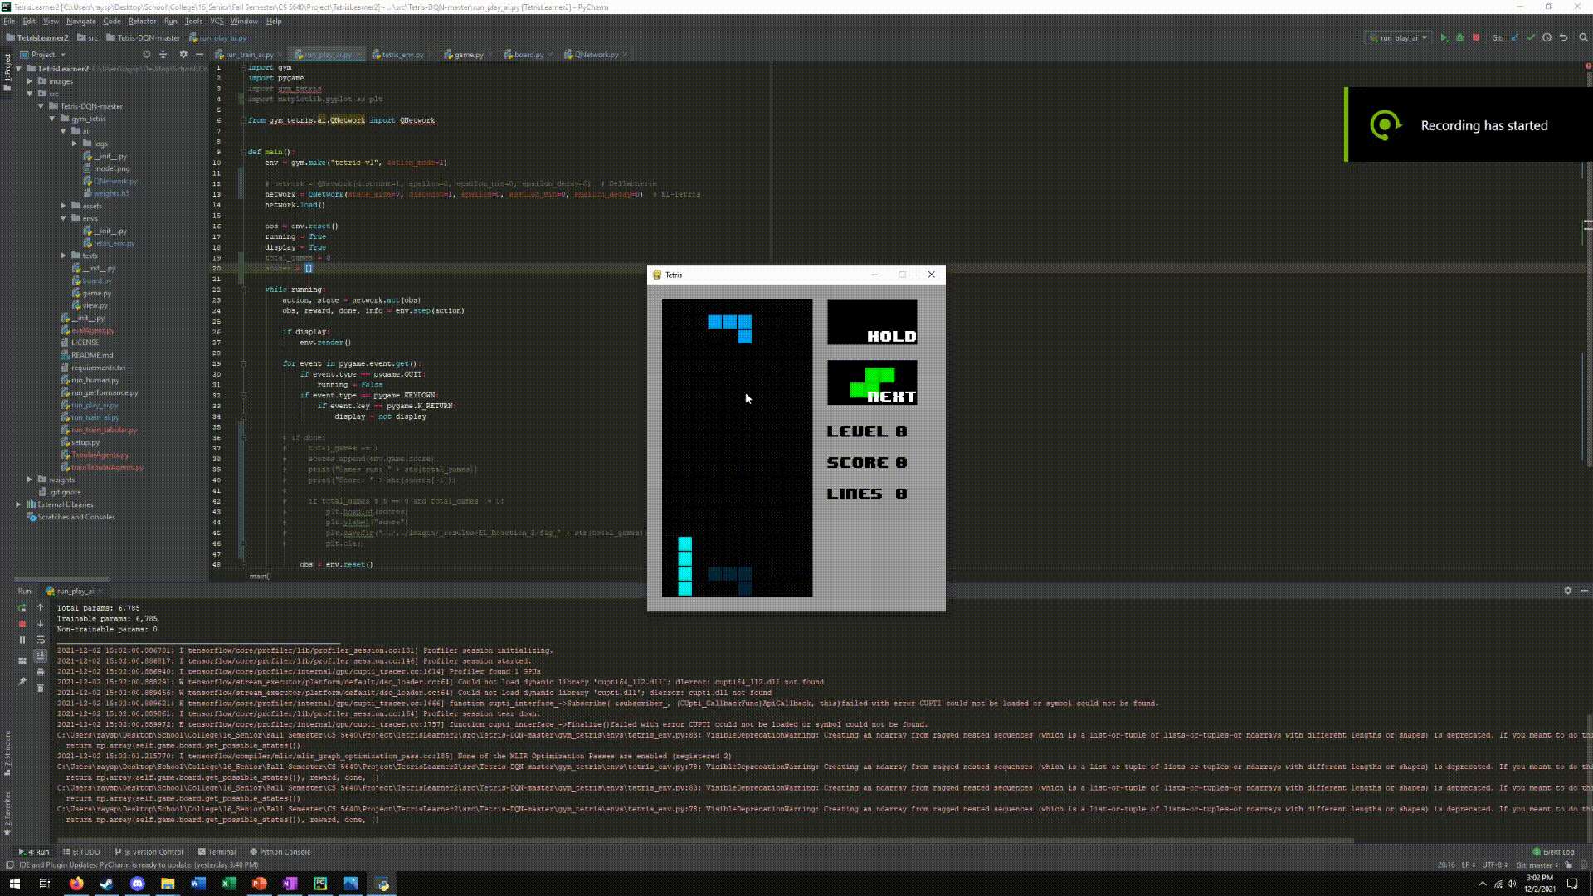
Results from various methods
Dellacherie’s Algorithm
EL-Tetris

Slide 5
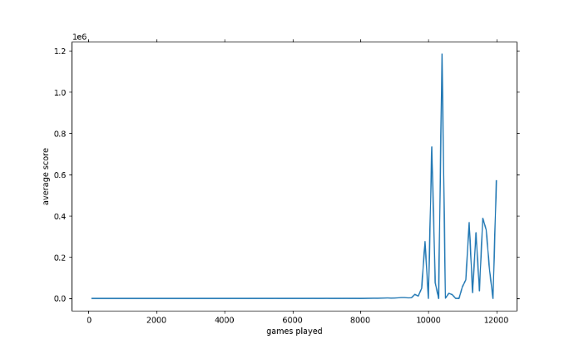
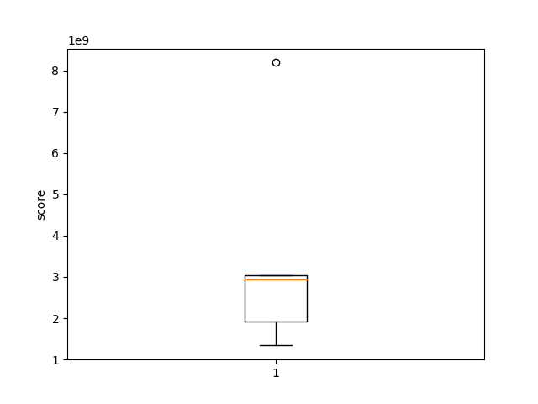
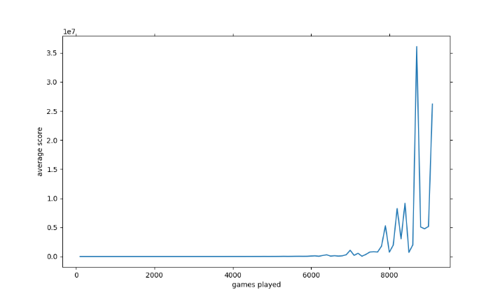
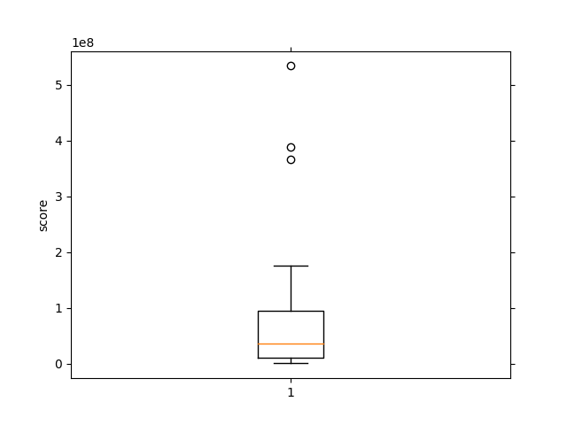
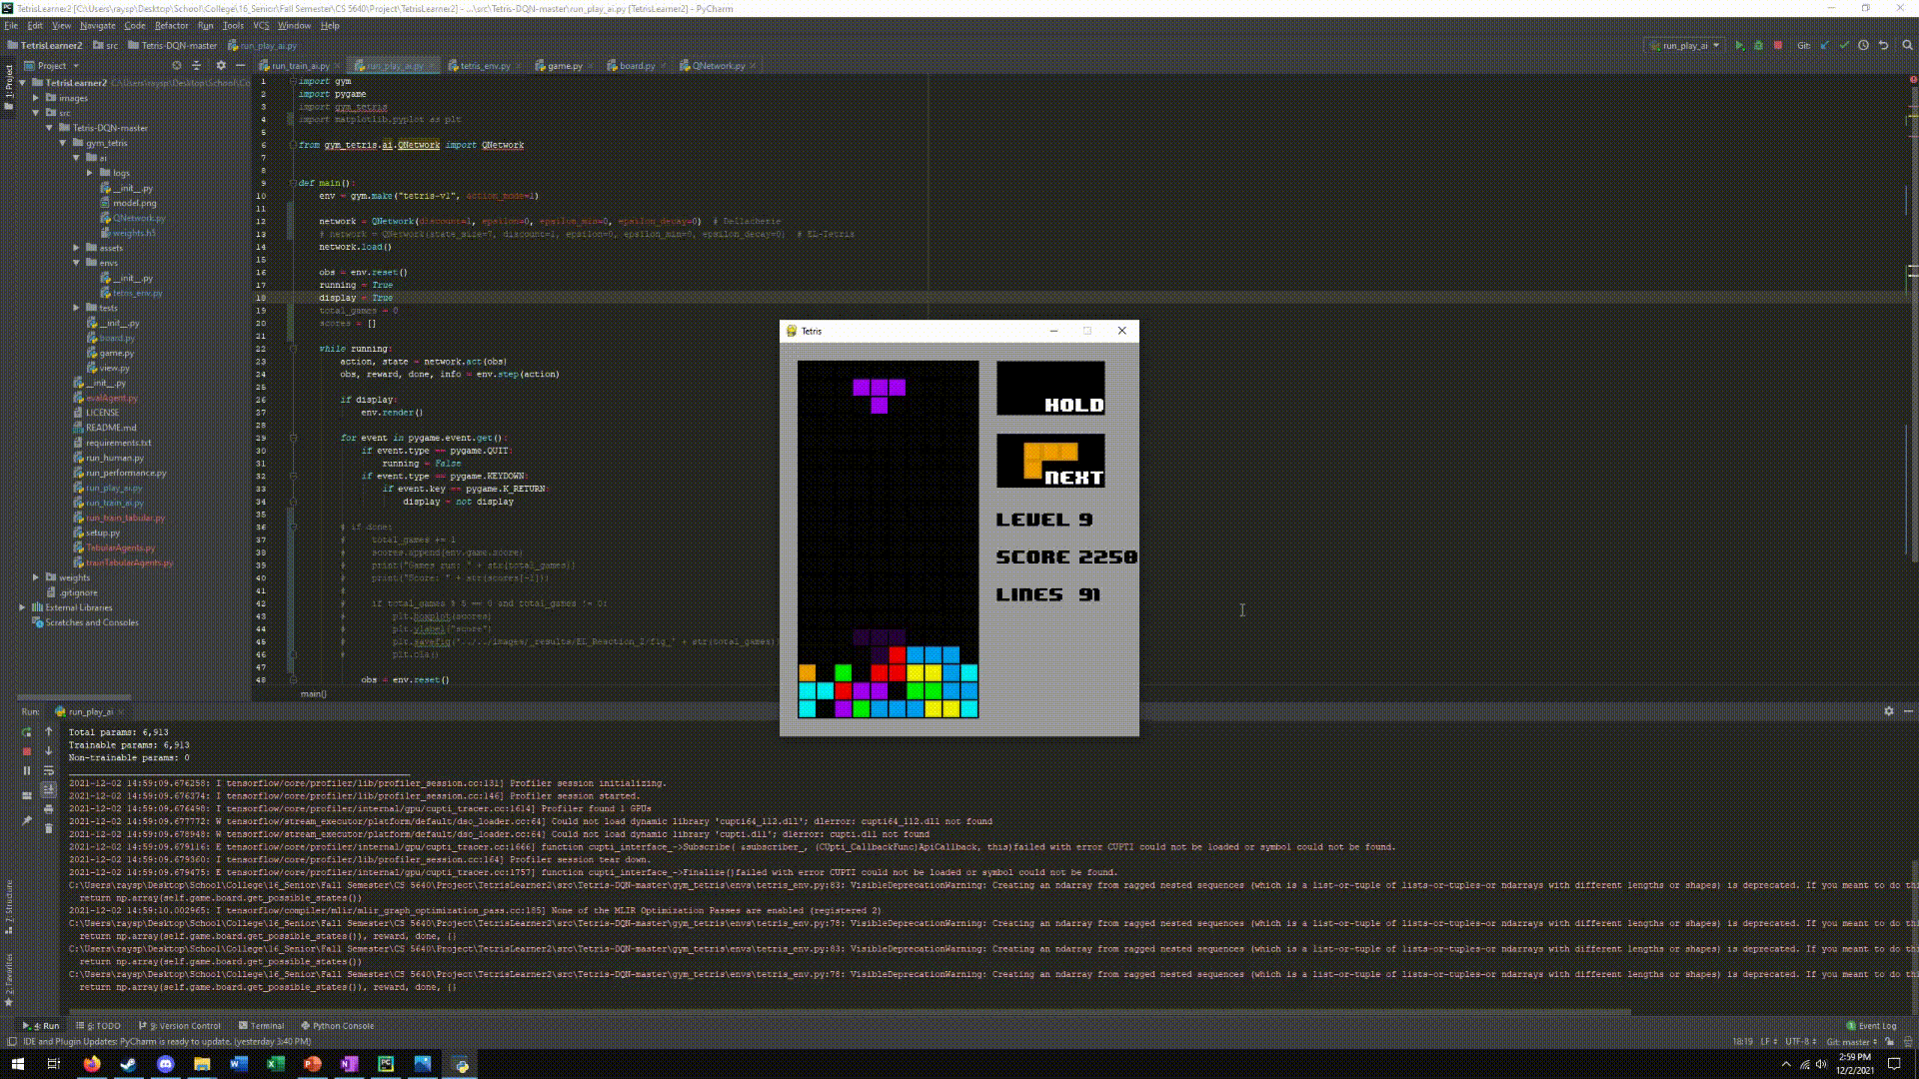
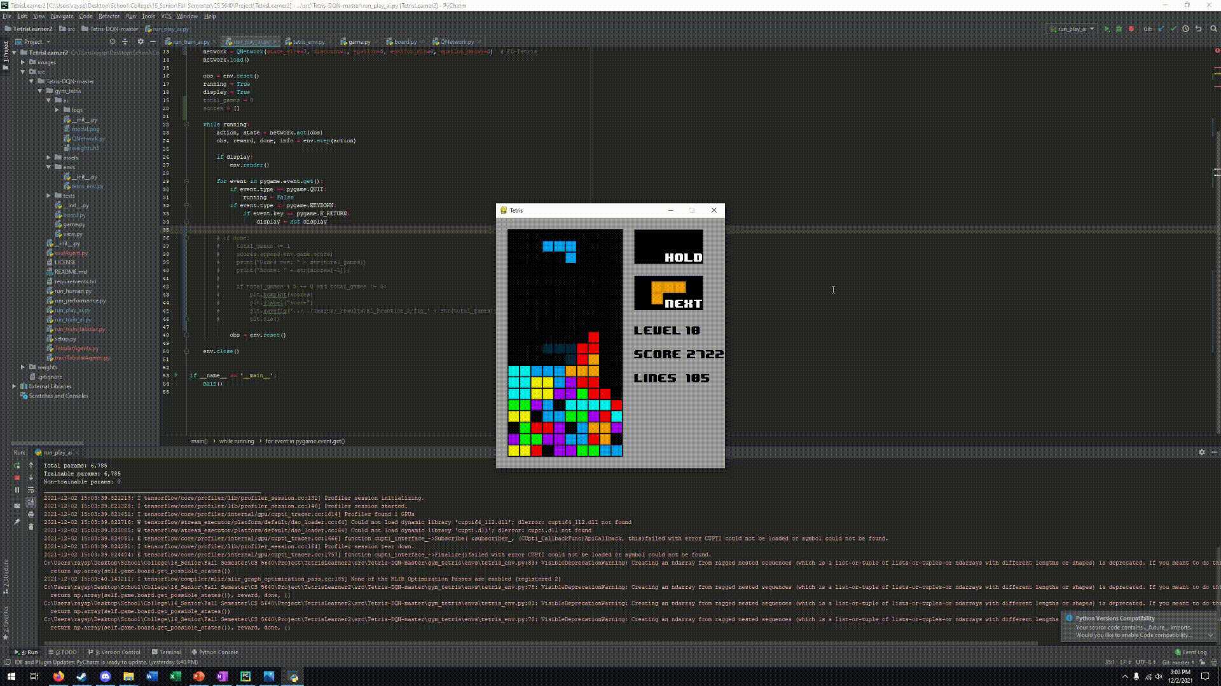
Results from various methods
Dellacherie’s w/ ½ reaction time
EL-Tetris w/ 1/2 reaction time

Slide 6
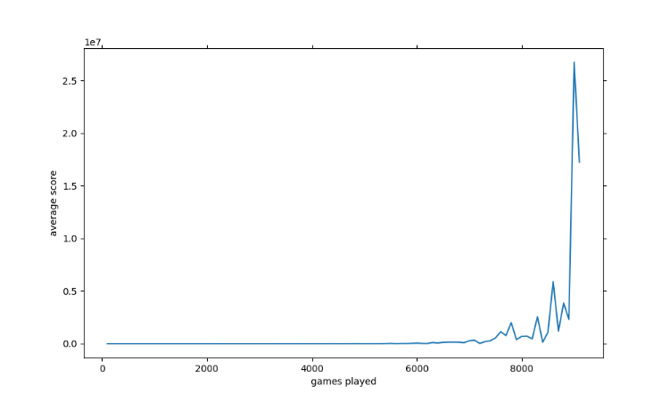
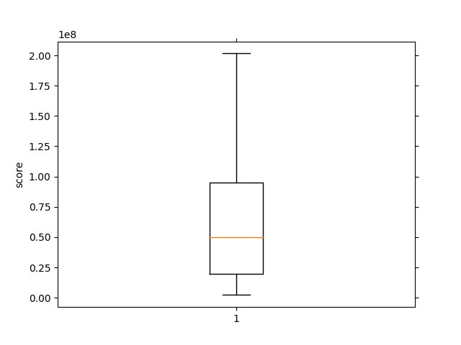
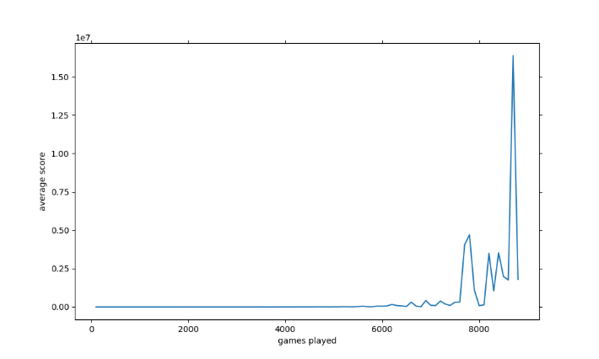
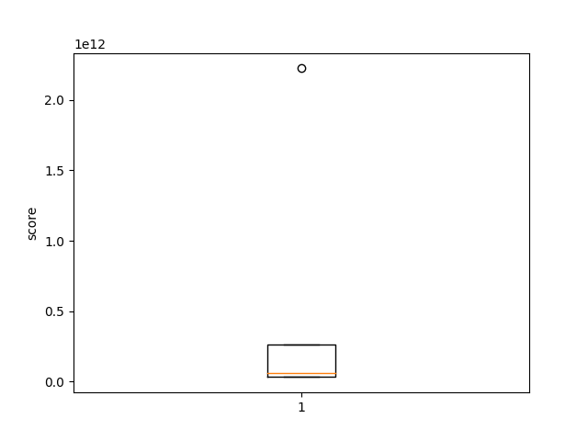
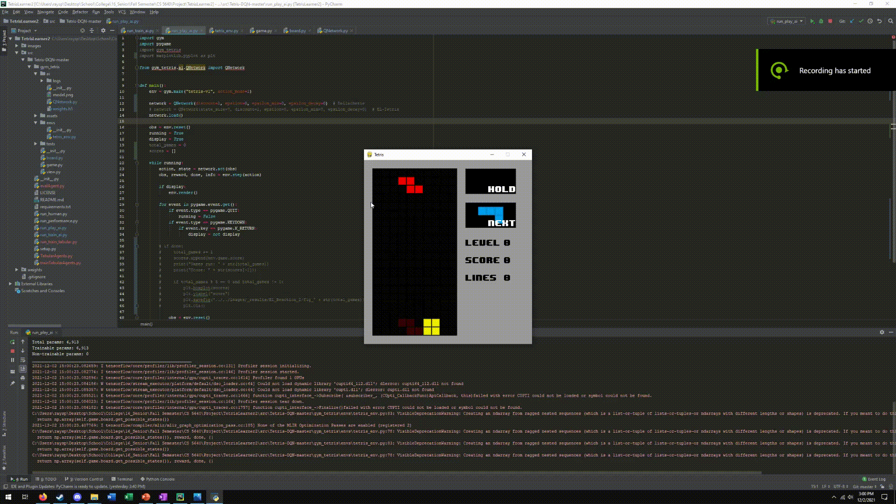
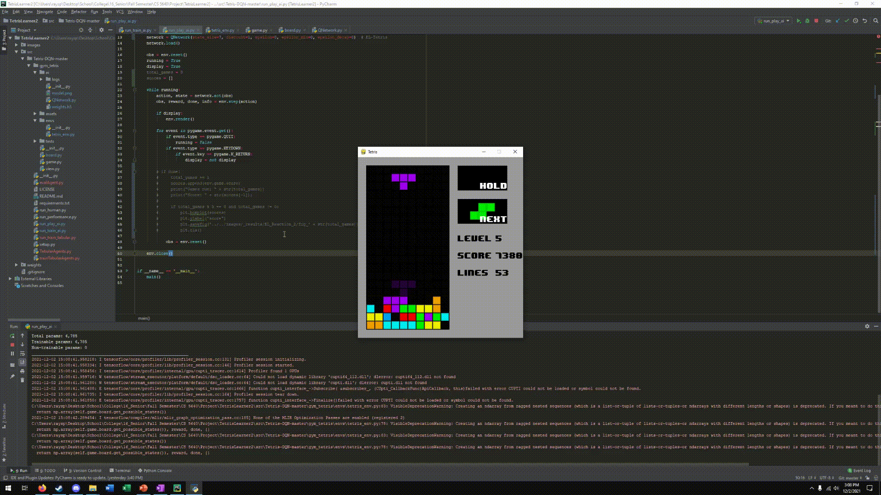
Results from various methods
Dellacherie’s w/ 1/3 reaction time
EL-Tetris with 1/3 limited reaction time

Slide 7
Conclusions & Where To Go Next
Improved state representations, imposed agent limitations, and a combination of both can lead a reinforcement learner to develop risk-reduction strategies.
Do these findings apply to other domains?
Can imposed limitations on the agent always be expected to improve the end results?
Can it be used to overcome problems in domains with infamously tricky local minima?

Slide 8
Sources
El-Ashi, Islam. “El-Tetris – an Improvement on Pierre Dellacherie’s Algorithm.” Imake, 1 June 2011, https://imake.ninja/el-tetris-an-improvement-on-pierre-dellacheries-algorithm/.
https://github.com/michiel-cox/Tetris-DQN

